Slide 1
C-CDA Encoding Issues and Solutions
Susan Matney, PhD, rnc-ob, faan
Rob mcclure, md

Slide 2
Value Sets Discussed Today
Value Set name | OID | Link | Code System
ADL Result Type | urn:oid:2.16.840.1.113883.11.20.9.47 | http://www.hl7.org | LOINC
Wound Characteristic | urn:oid:2.16.840.1.113883.11.20.9.58 | https://vsac.nlm.nih.gov | SNOMED CT
Wound Type | urn:oid:2.16.840.1.113883.1.11.20.2.6 | https://vsac.nlm.nih.gov | SNOMED CT

Slide 3
When is it ok to reuse a LOINC question from an existing instrument? Guidance From Dan Vreeman’s Blog
Be sure that you are asking the question in the same way
If question matches a particular LOINC code - evaluate the answer list
Normative – your answer list MUST match the selected answer list
Preferred
Lists contain a set of answers that users are strongly encouraged to use
User could have alternate result values if necessary.
Be aware of are external copyright notices
Source: https://danielvreeman.com/proper-use-of-loinc-question-codes-with-assessment-instrument-methods/

Slide 4
Activities of Daily Living (ADL) Result Type

Slide 5
ADL Type Concept Details
Issues with the use of survey concepts
Code | Descriptor | Comment
28408-3 | Toileting [QAM] | A code restricted to use in the HIV-QAM questionnaire AND has a LOINC Normative Answer list for the answers that does not align with the “Ability” value set to be used per the template. There is no LOINC code available that can be substituted that meets the requirement.
28409-1 | Dressing [QAM] | Same issue as above
28413-3 | Ambulation [QAM] | Same Issue as above
46008-9 | Bathing | This is a unusual LOINC panel-type code that collects more specific MDS questionnaire concepts. While Susan will investigate, we do not think this concept is “designed” to be a stand alone code, even if it was not tied to the MDS instrument.
46482-6 | Transferring | Exact same situation as above but this is in the OASIS questionnaire.
46484-2 | Feeding or eating | Same OASIS questionnaire situation as above.

Slide 6
ADL C-CDA Mapping Issues and Proposed Solutions
Issues
46008-9 Bathing is an MDS Panel (not an observation)
“Panel” is not in the LOINC component name
28409-1 Dressing, 28408-3; Toileting; 28413-3 Ambulation
Comes from the QAM (Quality Audit Marker)
Value sets are normative (not the C-CDA value set)
46482-6 Transferring and 46008-9 Bathing are OASIS Panels
“Panel” is not in the LOINC component name
Solution
LOINC include “Panel” in the component name where Panel Type = Panel
Create a new ADL panel with the above observations
Value set will not be normative and will include the values from the C-CDA
ADL SNOMED CT value set will be placed in VSAC

Slide 7
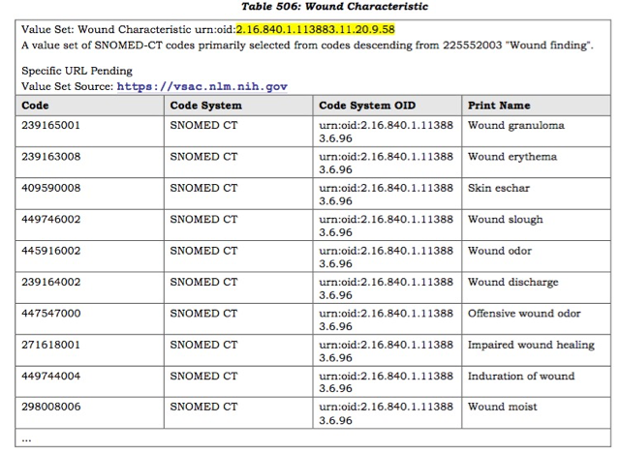
Wound Characteristics
Semantically incorrect
created as a list of assertions with no observation
Solution: use the LOINC specific observations for these (Wound odor, wound edge color, wound induration, etc.) with abov as values
Notes:
Double check – update slide, this is probably observables

Slide 8
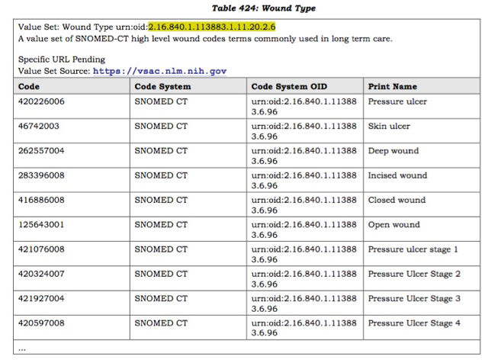
Wound Type
Incomplete value set
The most complete set was created by the nurses but not in VSAC
Solution – 1) ensure the value set contains the values above and 2) load value set

Slide 9
Moving Forward Discussion
Make sure all Panel’s are labeled as such
Balloted artifacts with terminology binding
Need a formal QA and validation process prior to balloting
Binding guidelines need to be established and published
Pre vs. post coordination
Normative vs. example value sets
What terminology to use when and where
Could possibly use the CIMI high level patterns to guide binding

